Slide 1
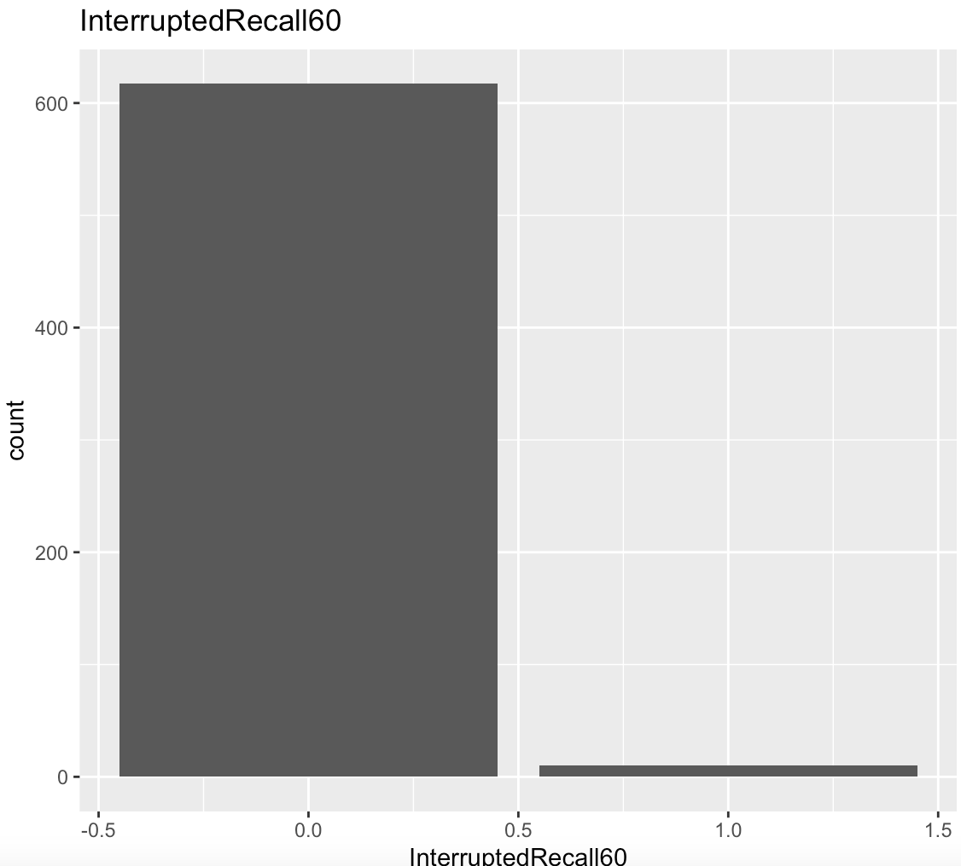
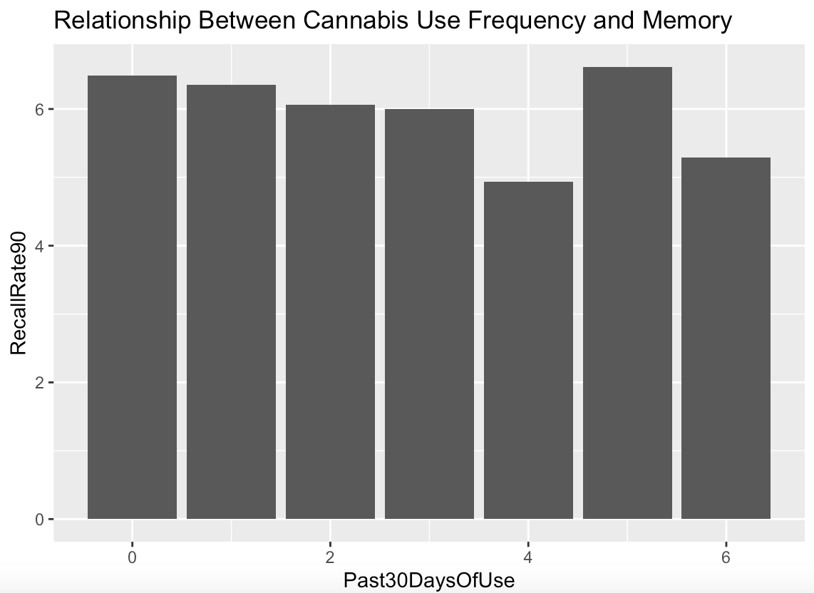
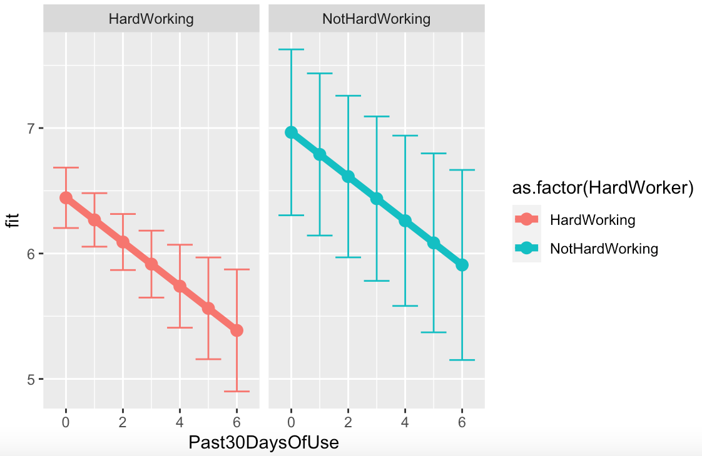
The Association Between Cannabis Consumption and Memory Capacity among Young Adults with and without Hard Working Tendencies
Mayu Alten, Applied Data Analysis, Wesleyan University
Introduction
Results
Cannabis is the most commonly used federally illegal drug in the U.S.(CDC). In 2019, the CDC found that there were approximately 48.2 million users across the country.
Harmful stereotypes fail to acknowledge the commonly overlooked reason for consistent cannabis use of medical treatment. Patients who struggle with anxiety, chronic pains, and many other issues are often prescribed cannabis, despite its notorious side effects.
These findings could help destigmatize cannabis in a professional and social sense.
Univariate
53.28% of respondents did not mistakenly recall a word not in the word string
27.36% of respondents named 1 wrong word
10.72% of respondents named 2 wrong words
4% of respondents named 3 wrong words
2% of respondents named 4 wrong words
Respondents who named more than 5 wrong words were extremely rare (approximately 1%)
Figure 1. Number of Recalled Words Not in List in 60 Second Word String Recall
Research Questions
Bivariate
An ANOVA analysis showed that there is not a significant association between whether an individual has attempted to quit cannabis consumption and numbers of wrong words recalled in 60 seconds from a word string(F(0.029)=1.19, p=0.864).
A Pearson correlation test was not necessary due to a high P-value.
Does a dependence on cannabis or the regular use of it cause a notably more significant decline in memory capacity?
Further, does whether an individual cannabis user considers themselves to be a hard worker or not impact levels of cognitive dysfunction, and if so, how much?
Figure 2. Past 30 Days of Use vs. 90 Second Recall
Methods
Sample
Respondents were drawn from the Add Health Wave 5 Questionnaire and Codebook, a nationally representative sample that provides relevant data collected from surveys given to a set of individuals in their late 30/40s between 2016 and 2019.
Measures
A lifetime incidence of marijuana use was measured with the question “Have you ever used marijuana?” Frequency of marijuana use was measured by assessing levels of cannabis use in the past 30 days. Possible responses ranged from 0 (never) to 6 (everyday). A variable reflecting dependence was coded dichotomously–habitual and non-habitual use.
Levels of memory retention were measured by giving individuals a word string to recite back in 90 and 60 second intervals. The results were assessed with a focus on whether there was any interruption during the memory task.
Hardworking nature was measured by asking individuals whether they consider themselves hard working or not.
Multivariate
Whether an individual considers themselves to be hard working is a moderator for the association between memory capacity vs. cannabis consumption (Figure 3).
After controlling for consistent cannabis use and hard working nature, memory capacity is significantly and positively associated with odds of remembering more words in the “90 second recall” (B=-0.1762, p<0.001).
Figure 3. Past 30 Days of Use vs. 90 Second Recall Controlling for Hard Workers and Non-Hard Workers
Discussion
Consuming cannabis on a regular basis may not affect individuals’ memory capacity.
When cannabis use is examined in tandem with an individual’s hardworking nature, their memory capacity displays no significant impact
if an individual considers themselves not to be a hard worker, they are likely to remember less words than their hard working counterpart holding all other variables fixed.
Counselors and psychiatrists might use this information to address the stigma surrounding medical marijuana use and increase openness to considering doctor-recommended treatment.
Further research is needed to determine what behaviors would qualify an individual as a “hard worker” to assess who would suffer more severe side effects.
Gerst, Kyle. “Delay Discounting of Losses in Alcohol Use ... - Wiley Online Library.” Delay Discounting of Losses in Alcohol Use Disorders and Antisocial Psychopathology: Effects of a Working Memory Load, https://onlinelibrary.wiley.com/doi/10.1111/acer.13472.
Kelly, Paul. “Does Recreational Ecstasy Use Cause Long-Term Cognitive Problems?” The Western Journal of Medicine, U.S. National Library of Medicine, Aug. 2000, https://www.ncbi.nlm.nih.gov/pmc/articles/PMC1071023/.
Meier, Madeline. Persistent Cannabis Users Show Neuropsychological Decline from ... - PNAS. https://www.pnas.org/doi/pdf/10.1073/pnas.1206820109.
Morin, Jean-François G., et al. “A Population-Based Analysis of the Relationship between Substance Use and Adolescent Cognitive Development.” American Journal of Psychiatry, vol. 176, no. 2, 2019, pp. 98–106., https://doi.org/10.1176/appi.ajp.2018.18020202.
Muisener, Philip P. “Chapter 1.” Understanding and Treating Adolescent Substance Abuse, Sage Publications, Thousand Oaks, 1994.

